Slide 1
JCM OSCE
TMH AED
Nov 2013

Slide 2
Case 1
M/66
Known HT FU private
c/o Chest pain since 1 hour ago
BP 133/84 P 65 T 36
Physical exam unremarkable
Chest X-ray unremarkable

Slide 4
Name the ECG abnormalities
ST elevation over II, III, AVF (0.5)
ST elevation in III > ST elevation in II (0.5)
Reciprocal ST depression over I, AVL (0.5)
ST depression over V2 (0.5)

Slide 5
What are the possible territories involved?
Inferior (0.5)
Posterior (0.5)
Right ventricle (0.5)

Slide 8
Name the most likely culprit artery
Right coronary artery (1)
Notes:
Interhospital transfer to a PCI-capable hospital is the recommended triage strategy if primary PCI consistently can be performed within 120 min- utes of FMC. Fibrinolytic therapy, in the absence of contrain- dications to its use, should be administered within 30 minutes of first door arrival when this 120-minute time goal cannot be met.
A door-in–door-out time ≤30 minutes, achieved in only 11% of patients, was associated with shorter delays to reperfusion and a lower in-hospital mortality rate.

Slide 9
The patient is in a local hospital where PCI is unavailable.
What is the preferred treatment according to the latest AHA guidelines?
Transfer the patient for primary percutaneous coronary intervention(PCI) (1)

Slide 10
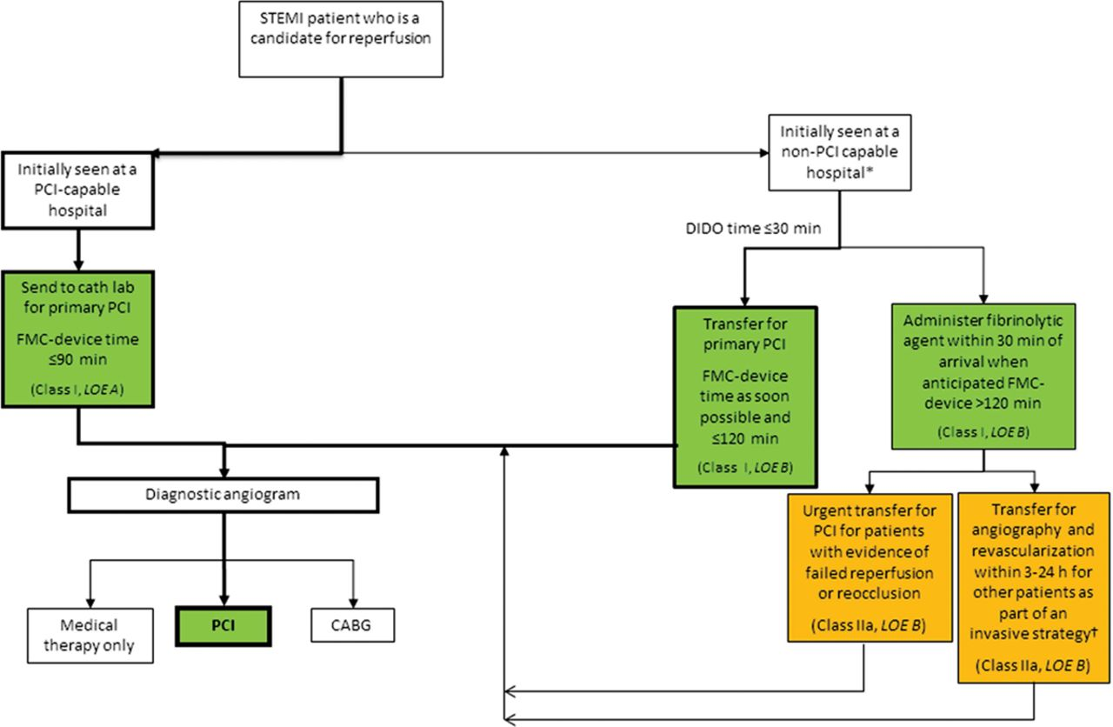
Reperfusion therapy for patients with STEMI. The bold arrows and boxes are the preferred strategies.
O’Gara P et al. Circulation 2013;127:529-555
Copyright © American Heart Association
Notes:
Reperfusion therapy for patients with STEMI. The bold arrows and boxes are the preferred strategies. Performance of PCI is dictated by an anatomically appropriate culprit stenosis. *Patients with cardiogenic shock or severe heart failure initially seen at a non–PCI-capable hospital should be transferred for cardiac catheterization and revascularization as soon as possible, irrespective of time delay from MI onset (Class I, LOE: B). †Angiography and revascularization should not be performed within the first 2 to 3 hours after administration of fibrinolytic therapy. CABG indicates coronary artery bypass graft; DIDO, door-in–door-out; FMC, first medical contact; LOE, Level of Evidence; MI, myocardial infarction; PCI, percutaneous coronary intervention; and STEMI, ST-elevation myocardial infarction.

Slide 11
Suppose tenecteplase was given for thrombolysis, however the patient developed VF arrest & cardiogenic shock after ROSC.

Slide 12
What treatment should be considered?
Transfer to patient for Rescue PCI (1)

Slide 13
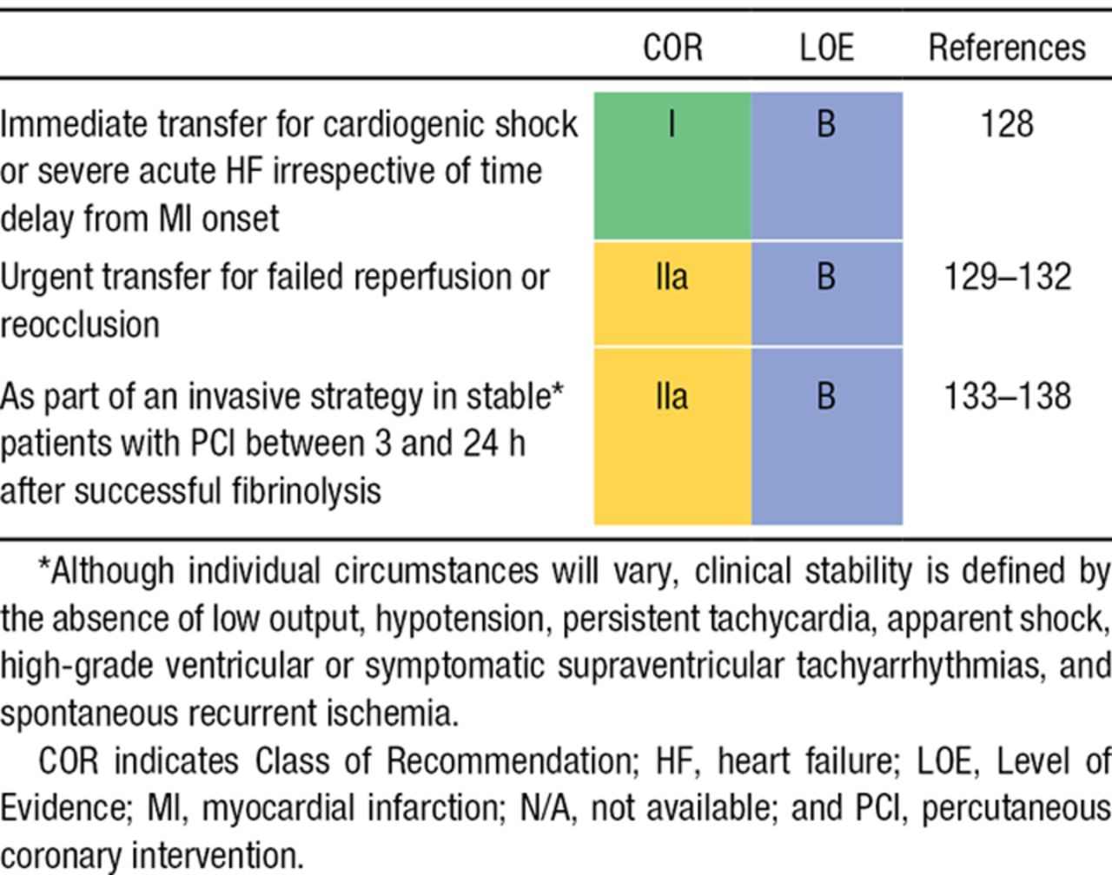
Indications for Transfer for Angiography After Fibrinolytic Therapy.
O’Gara P et al. Circulation 2013;127:529-555
Copyright © American Heart Association
Notes:
Indications for Transfer for Angiography After Fibrinolytic Therapy

Slide 14
Case 2
M/44
Known HT
c/o Severe low back pain
BP 192/112 P 67 T 36 SpO2 99% (RA)
CT was performed

Slide 17
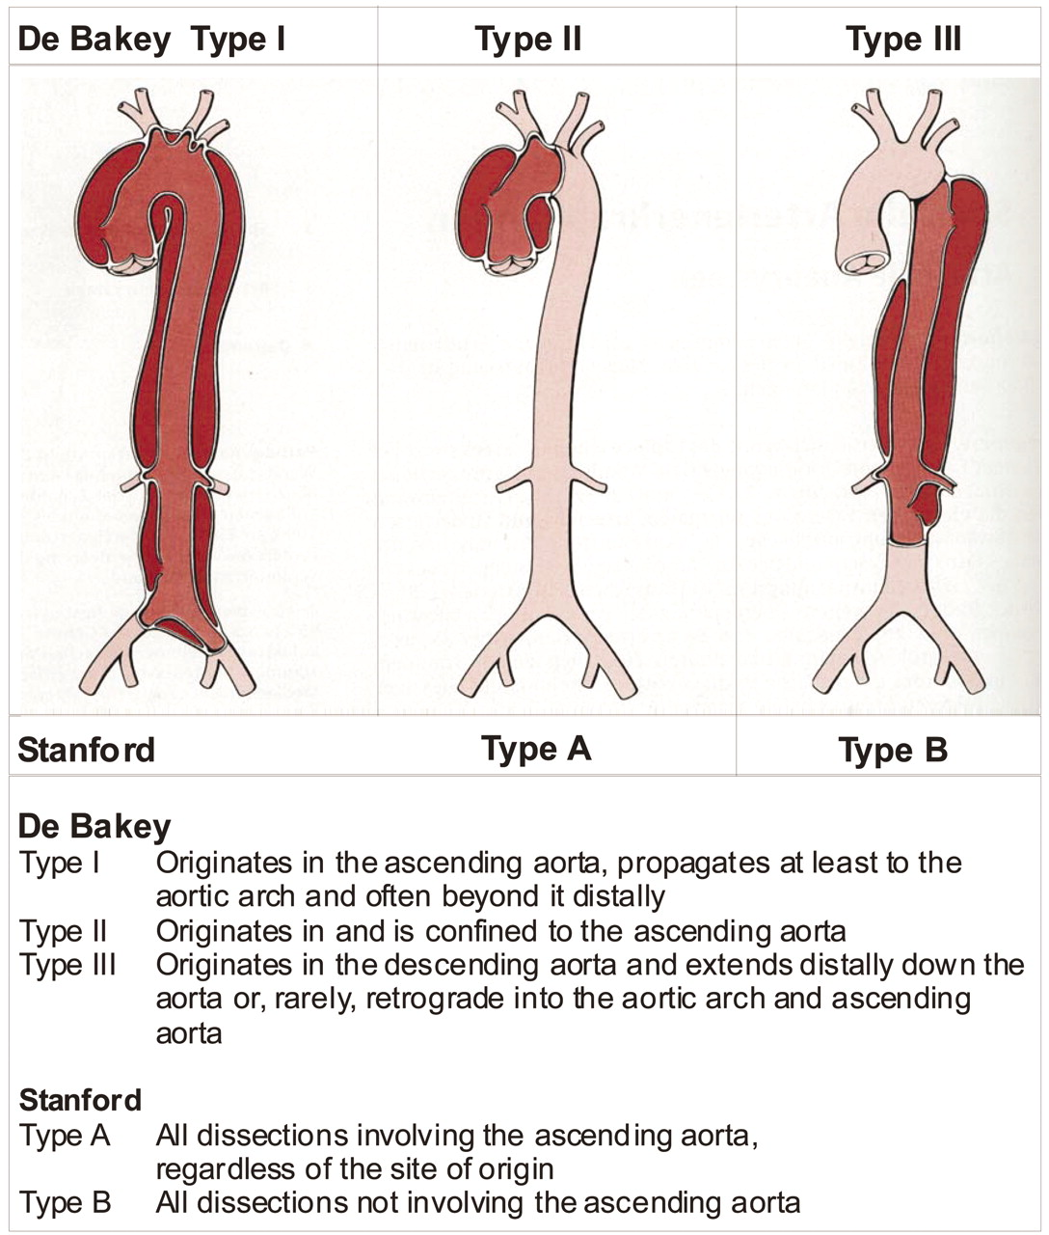
Figure 1. The most common classification systems of thoracic aortic dissection: Stanford and DeBakey.
Nienaber C A , and Eagle K A Circulation 2003;108:628-635
Copyright © American Heart Association
Notes:
Figure 1. The most common classification systems of thoracic aortic dissection: Stanford and DeBakey.

Slide 18
What is the diagnosis?
Stanford Type B (De Bakey Type III) Intramural Hematoma (1+1)

Slide 19
Outline initial management with target end-points
IV opiate for pain control (0.5)
IV beta blockade (0.5) with target heart rate <60 (0.5)
IV vasodilators only after giving negative inotropic agents to avoid increase in shear force (0.5); target blood pressure <120 mmHg (0.5)

Slide 20
When to consider alternative treatments?
Operative or interventional management if:
Malperfusion syndrome (0.5)
Progression of dissection (0.5)
Uncontrolled hypertension (0.5)
Aneurysm expansion (0.5)

Slide 21
This condition belongs to a spectrum of diseases. What is the spectrum called?
Acute aortic syndrome (1)

Slide 22
Case 3
F/55
PH: Ca rectum with total mesorectal excision & ileostomy 1 year ago
Closure of ileostomy 2 weeks ago
c/o Persistent wound pain, swelling, low grade fever

Slide 24
Describe the X-ray findings
Surgical emphysema over right abdominal wall
Presence of air-fluid levels in bowel loops

Slide 26
Describe the abnormalities in CT
Surgical emphysema over right abdominal wall
Collection with multiple gas, fluid and soft tissue density in right side of abdomen with extension to right anterior abdominal wall

Slide 27
What is your diagnosis?
Enterocutaneous fistula

Slide 28
List 4 common etiologies
Post-operative
Trauma
Foreign body
Inflammatory bowel disease
Tuberculosis
Diverticulitis
Carcinoma
(any 4, 0.5 each)

Slide 29
List 4 important aspects in conservative treatment
Rehydration
Administration of antibiotics
Correction of anemia
Electrolyte repletion
Drainage of obvious abscess
Nutritional support
Control of fistula drainage
Skin protection (any 4, 0.5 each)

Slide 30
When should corrective surgery be considered?
Non-closure after non-operative management for 4-6 weeks (1)

Slide 31
Case 4
F/47
PH: Schizophrenia
DO 40 tab amisulpride (800mg/tab) 10 tab ativan (1mg/tab) 1.5 hours ago
BP 81/31 P82 SpO2 100% GCS 14 Pupil 3mm

Slide 32
(a) What is the most important cardiac toxicity of amisulpride overdose?
Prolonged QT interval (1)

Slide 33
(b) Name 4 other drug classes causing similar effect as in (a)
Antiarrhythmic
Antidepressant
Antihistamine
Antimicrobial
(0.5 x 4)

Slide 34
(c) What arrhythmia can the above drugs cause?
Torsades de pointes (0.5)

Slide 36
(d) Name the antidotes for amisulpride
Magnesium (1)
Sodium bicarbonate (1)

Slide 37
(e) How long should an asymptomatic patient with normal ECG be observed?
At least 12 hours (1)

Slide 38
Case 5
F/54
Fall when walking downstairs in bus
c/o R knee pain

Slide 40
Describe the XR finding
Fracture right medial tibial condyle with depressed articular fragment

Slide 42
What is the usual injury mechanism?
Valgus or varus forces with axial loading (1)

Slide 43
Which site is more commonly involved?
Lateral tibial plateau (0.5)

Slide 44
Name the classification system
Schatzker Classification (1) or
Hohl and Moore Classification (1)
Handbook of fractures 4th Ed.

Slide 45
What does lipohemarthrosis indicate?
Intra-articular fracture with escape of fat and blood from the bone marrow into the joint (1)
www.radiopaedia.org

Slide 46
List 4 indications of operative repair
Articular stepoff > 3mm
Condylar widening > 5mm
Varus/valgus instability
Medial plateau fractures
Bicondylar fractures
Open fractures
Associated compartment syndrome
Associated vascular injury (0.5 each)

Slide 47
Thank You

